Slide 1
LeanFT HP ALM
Eclipse – JUnit - Java

Slide 2

LeanFT HP ALM & Jenkins Integration
Eclipse – JUnit - Java
Agenda
Automation Overview
Architecture: LeanFT with JUnit testing framework
Overview: Create Test Case/Test Scripts and Intergrate with HP ALM
Configuration to run LeanFT test case remotely
Overview CI solution with Jenkins
Configuration for Remote/Virtual Machine and Jenkins
Overview: Work Flow of triggering Test on Remote/Virtual Machine
Questions & Answers

Slide 3
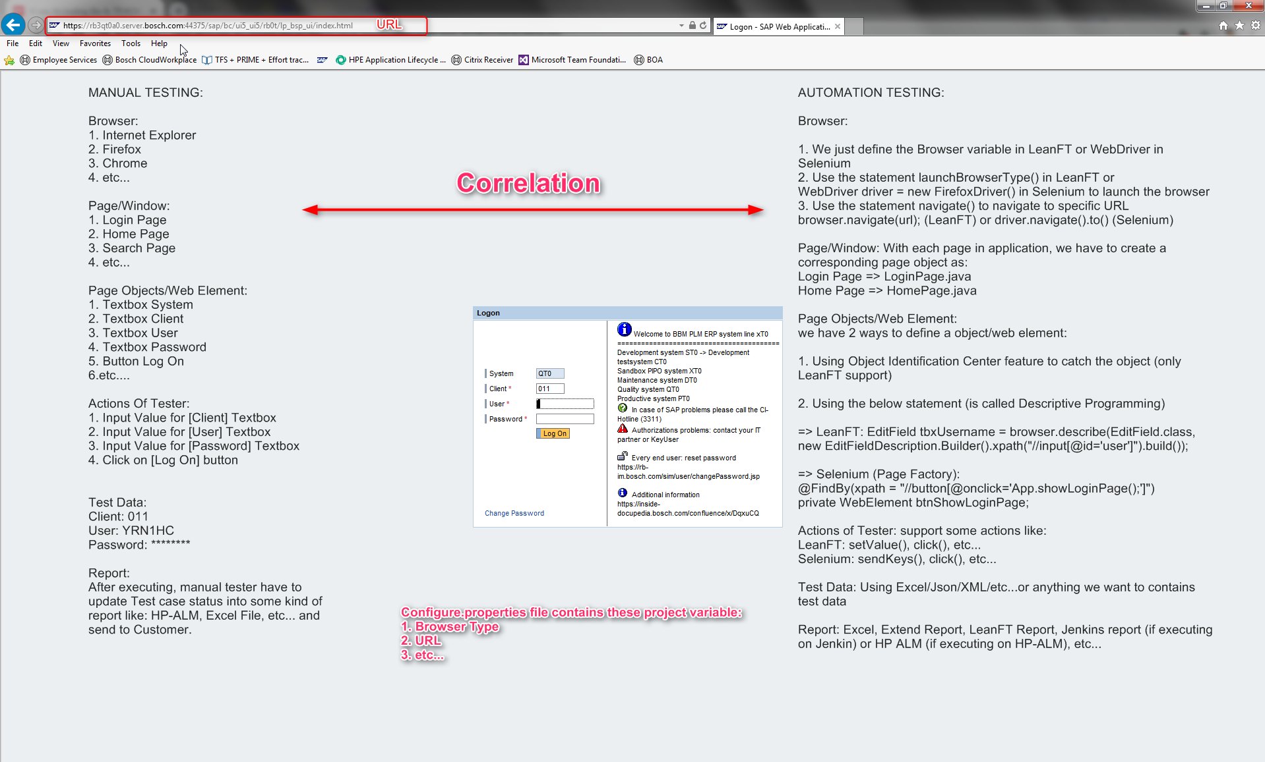

Slide 4
Identify Web Element using XPath
All of Web Elements is always HTML
Example about HTML:
1. Button [Google Search]
<input value="Google Search" aria-label="Google Search" name="btnK" type="submit">
2. Link [Gmail]
<a class="gb_P" data-pid="23“ href="https://mail.google.com/mail/?tab=wm">Gmail</a>
Definition:
HTML Tag: <input>, <a>
Attribute: value, aria-label, name, type, class, href, etc…
Text: Gmail
XPATH syntax:
//tagName[@atttributeName=‘unique_value’]
//tagName[text()=‘unique_value’]
Example: using Inspector Element function on Firefox to identify web element [$x(“”)]
Button [Google Search]
//div[@class='FPdoLc VlcLAe']//input[@value='Google Search']
Link [Gmail]
//a[text()='Gmail']

Slide 5
extends
UnitTestClassBase
extends
Get data
CommonWebActions
Reports
Config.properties
Test Cases
extends
Get test data
Pages/Windows
Get objects
Objects Repository
Test Data
Define methods
Actions Of Test
Click(), setValue()

Slide 6
UnitTestClassBase
Include some methods:
@Before
public void beforeTest() throws Exception {
testSetup();
launchBrowser(); //Launch Browser or Application
}
@After
public void afterTest() throws Exception {
browser.close(); //Close Browser or Application
}
public static void globalTearDown() throws Exception {
instance.classTearDown();
getReporter().generateReport(); //initialize LeanFT Report Event
}

Slide 7
CommonWebActions
Customized the function click(), setValue(), verify(), etc….to insert the step into LeanFT report every the function is called.
Example:
public <T extends WebElement> void click(T webElement, String webElementName) {
try {
webElement.highlight();
webElement.click();
assertStep(String.format("Clicked on %s", webElementName), "", Status.Passed);
//included assertStep to insert the step to the Report
} catch (Exception ex) {
assertStep(String.format("Clicked on %s", webElementName), String.format("ERROR: ", ex.getMessage()), Status.Failed);
//included assertStep to insert the step to the LeanFT Report
}
}
public <T extends EditFieldCommon> void setValue(T webElement, String value, String webElementName){
try{
webElement.setValue(value);
assertStep(String.format("Input value [%s] into %s", value, webElementName), "", Status.Passed);
}
catch (Exception ex) {
assertStep(String.format("Input value [%s] into %s", value, webElementName), String.format("ERROR: ", ex.getMessage()), Status.Failed);
}
}

Slide 8
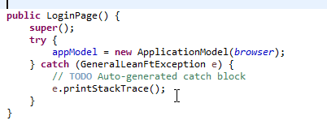
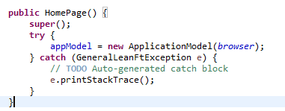

Pages/Windows
Will create the java class as LoginPage.java, HomePage.java, etc….In each of page, we initialize Object Repository and define the methods as login(), search(), etc…
Object Repository
Initialize Object Repository before using (should be initialize in Constructor of java class:
Actions of Tester

Slide 9
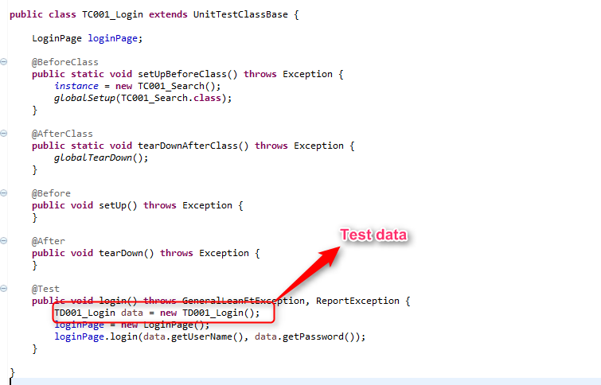
Test cases
Create the test case class as TC001_Login.java, TC002_Search.java

Slide 10
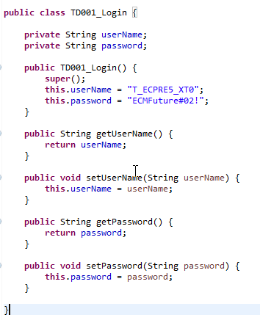
Test data
Create the test data class as TD001_Login.java, TD002_Search.java. We can use XML, Excel, Json, etct to contain test data. All of what we need to create the methods to read, write, update, delete test data.
Example: Using TD001_Login.java class to contain test data

Slide 11

Configure.properties file
Contains the project variable like: browserType, URL, SUT (system under test)

Slide 12
3. Questions & Answer

